Slide 1


Cryptography
&
Network Security
Lecture Slide 4
CSE Department
UEM, Kolkata

Slide 2

Topics to be Covered
Transposition Technique
Cryptosystem
Modern Cipher System
  Stream Cipher
  Block Cipher
Classical Cryptography vs Modern Cryptography

Slide 3
Transposition Technique
Transposition Ciphers are a bit different to Substitution Ciphers. Whereas Substitution ciphers replace each letter with a different letter or symbol to produce the cipher text, in a Transposition cipher, the letters are just moved around. The letters or words of the plaintext are reordered in some way, fixed by a given rule (the key).
One example of a transposition cipher, is to reverse the order of the letters in a plaintext. So "a simple example" becomes "ELPMAXE ELPMIS A". Another, similar, way to encrypt a message would be to reverse the letters of each word, but not the order in which the words are written. In this case "a simple example" becomes "A ELPMIS ELPMAXE". Both of these are available in the activity at the bottom of the page.
Another type of transposition cipher is the Scytale, which was an encryption device used by the Ancient Greeks and Spartans. It consisted of a polygonal rod or cylinder, around which was wrapped a piece of parchment. The sender would write the message along the faces of the rod as seen in the image below. When the parchment is removed from the Scytale, it leaves a nonsensical message going down the strip (in the case below it would read "STSF...").

Slide 4
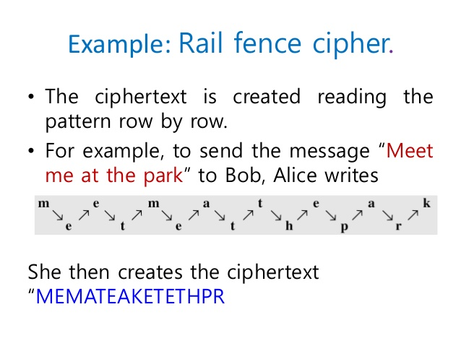
Rail Fence Cipher

Slide 5
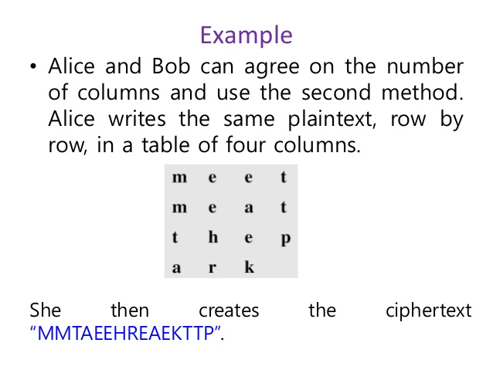

Slide 6
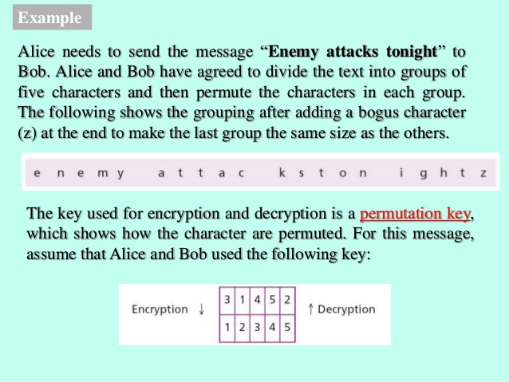

Slide 7
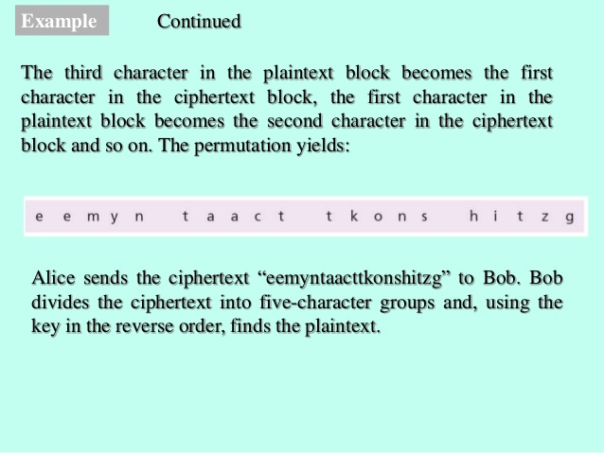

Slide 8
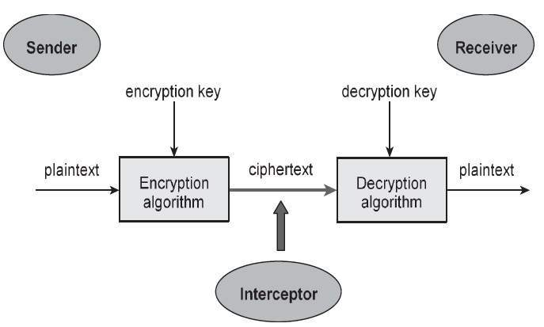
Cryptosystems
Cryptosystem is an implementation of cryptographic techniques and their accompanying infrastructure to provide information security services. A cryptosystem is also referred to as a cipher system.

Slide 9
Types of Cryptosystems
Fundamentally, there are two types of cryptosystems based on the manner in which encryption-decryption is carried out in the system −
Symmetric Key Encryption
Asymmetric Key Encryption
The main difference between these cryptosystems is the relationship between the encryption and the decryption key. Logically, in any cryptosystem, both the keys are closely associated. It is practically impossible to decrypt the ciphertext with the key that is unrelated to the encryption key.

Slide 10
Symmetric-key cryptography
The encryption process where same keys are used for encrypting and decrypting the information is known as Symmetric Key Encryption.
The study of symmetric cryptosystems is referred to as symmetric cryptography. Symmetric cryptosystems are also sometimes referred to as secret key cryptosystems.
A few well-known examples of symmetric key encryption methods are − Digital Encryption Standard (DES), Triple-DES (3DES), IDEA, and BLOWFISH.

Slide 11
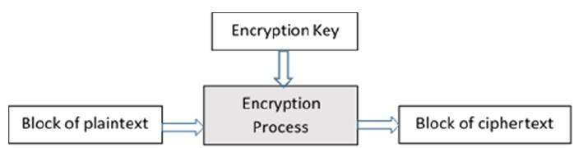
Block Cipher
A block cipher takes a block of plaintext bits and generates a block of ciphertext bits, generally of same size. The size of block is fixed in the given scheme. The choice of block size does not directly affect to the strength of encryption scheme. The strength of cipher depends up on the key length.

Slide 12
Block Size
Though any size of block is acceptable, following aspects are borne in mind while selecting a size of a block.
Avoid very small block size − Say a block size is m bits. Then the possible plaintext bits combinations are then 2^{m}. If the attacker discovers the plain text blocks corresponding to some previously sent cipher text blocks, then the attacker can launch a type of ‘dictionary attack’ by building up a dictionary of plaintext/cipher text pairs sent using that encryption key. A larger block size makes attack harder as the dictionary needs to be larger.
Do not have very large block size − With very large block size, the cipher becomes inefficient to operate. Such plaintexts will need to be padded before being encrypted.
Multiples of 8 bit − A preferred block size is a multiple of 8 as it is easy for implementation as most computer processor handle data in multiple of 8 bits.

Slide 13
Block Cipher Schemes
Digital Encryption Standard (DES) − The popular block cipher of the 1990s. It is now considered as a ‘broken’ block cipher, due primarily to its small key size.
Triple DES − It is a variant scheme based on repeated DES applications. It is still a respected block ciphers but inefficient compared to the new faster block ciphers available.
Advanced Encryption Standard (AES) − It is a relatively new block cipher based on the encryption algorithm Rijndael that won the AES design competition.
IDEA − It is a sufficiently strong block cipher with a block size of 64 and a key size of 128 bits. A number of applications use IDEA encryption, including early versions of Pretty Good Privacy (PGP) protocol. The use of IDEA scheme has a restricted adoption due to patent issues.
Twofish − This scheme of block cipher uses block size of 128 bits and a key of variable length. It was one of the AES finalists. It is based on the earlier block cipher Blowfish with a block size of 64 bits.

Slide 14
Stream Ciphers
In this scheme, the plaintext is processed one bit at a time i.e. one bit of plaintext is taken, and a series of operations is performed on it to generate one bit of cipher text. Technically, stream ciphers are block ciphers with a block size of one bit.

Slide 15
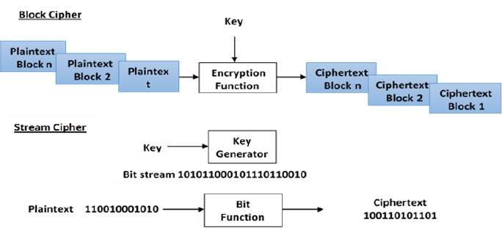
Block Cipher vs Stream Cipher

Slide 16
There are three major characteristics that separate modern cryptography from the classical approach.
Classic Cryptography | Modern Cryptography
It manipulates traditional characters, i.e., letters and digits directly. | It operates on binary bit sequences.
It is mainly based on ‘security through obscurity’. The techniques employed for coding were kept secret and only the parties involved in communication knew about them. | It relies on publicly known mathematical algorithms for coding the information. Secrecy is obtained through a secrete key which is used as the seed for the algorithms. The computational difficulty of algorithms, absence of secret key, etc., make it impossible for an attacker to obtain the original information even if he knows the algorithm used for coding.
It requires the entire cryptosystem for communicating confidentially. | Modern cryptography requires parties interested in secure communication to possess the secret key only.

Slide 17


